Slide 1
RUGBY PUNTING
Coach Canterbury
Bartram Trail HS Specialist Coach
Twitter: @Coach Canterbury

Slide 2
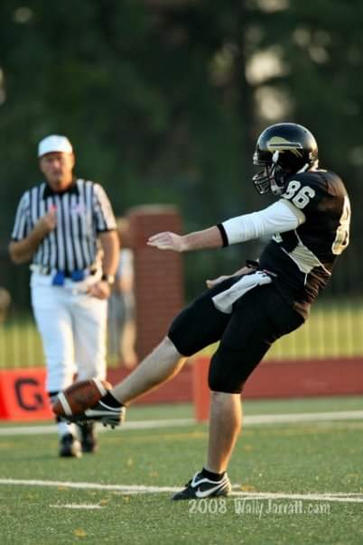
Why Rugby Punting Works
SIMPLE TRANSITION
VERSITILITY
UNPREDICTABILITY
MARKETABILITY
ANOTHER TOOL IN THE TOOLBOX

Slide 3
SIMPLE TRANISTION
Most of Linear Punting rules apply: -Molding, Step length, Ball Angle, Drop, Body Position, Leg Swing *
Differences: -Drop Table to “Waist Band” -Lateral Shuffle Step -3-5 Steps on a 45-degree angle - Follow through downfield following the ball

Slide 4
VERSITILITY
Unexpected change from Traditional Linear Punting
More Options of Intentional Ball Flight - End over End - Nose over Nose - Sidewinder - Spiral
More Fake Punt Options

Slide 5
(UN)PREDICTABILITY
predictable
unpredictable
Punt Direction/ Landing Zone
Use of Field Conditions
Less Likely to Return a Rolling Ball
More time for coverage to get down field due to slightly longer or even longer Op. Time = Return Yardage
In- Game scouting changes. - Returners change alignment expecting Linear Punt, Rugby Punt is a surprise. Track across the field.
Bounce and Roll
Roll out could produce a fake if coverage bails
Roll out right- intentional punt left if Returner Adjusts pre-snap.

Slide 6
Marketability
The more you can do as a Specialist, the more marketable to colleges you become.
Recruiters love to use one scholarship on one Specialist to do all aspects of the kicking game. It alleviates another scholarship for another position player.
56 of 130 D-1 Programs are scheming for Rugby Punters as of 2021 Season. Raise your Recruiting Value by having an arsenal of punt types.

Slide 7
2021-22 Season Usage
56 of 130 D-1 Programs use “Aussie/Rugby Style” Punters:
Source: https://www.sportingnews.com/us/ncaa-football/news/prokick-australia-flooding-college-football-australian-punters/1o7ejygxjto5h12sqsszkt6pgm

Slide 8
Media Attention
https://www.sportingnews.com/us/ncaa-football/news/prokick-australia-flooding-college-football-australian-punters/1o7ejygxjto5h12sqsszkt6pgm
https://www.americanfootballinternational.com/college-footballs-australian-punting-invasion/
https://www.foxsports.com/stories/college-football/how-australian-punters-are-taking-over-college-football
https://bleacherreport.com/articles/898757-alabama-football-rugby-style-punt-killing-tides-return-game
“The rugby style has been showcased against the Alabama Crimson Tide for the past three weeks. After punt-returner Marquis Maze returned a punt for 83 yards for a touchdown against Arkansas, Florida went with the rugby style for the entire game the following week.” Source- Bleacher Report Article Above

Slide 9
Another Tool In The Toolbox
Weaponize yourself!
i.e. Pinning the ball inside the 10 outside the numbers with roll FROM the left hash to the right hash.

