Slide 1
MENTAL CONDITIONING
(McGuire, R., Selking, A., & Ivey, P., 2018)

Slide 2
Mcguire-Ivey-Selking Model of Mental Toughness
(McGuire, R., Selking, A., & Ivey, P., 2018)
Notes:
All teachings based from the Mental Toughness Pyramid. In doing so, tools build off one another and merge together into two concepts that lead to the overall result of Optimal Performance.

Slide 3

2 COMPONENTS
Thinking Right In Sport
Mental Toughness
X
Notes:
All inclusive. Eventually turns into Lower classmen and upper classmen sections

Slide 4
Thinking Right in Sport
Thinking Right in Sport
Positive Self Talk
Optimal Arousal
Concentration
Confidence
From Whistle To Snap
Notes:
Thinking Right in Sport: Overview base sections of pyramid and Focus section.Thinking right is a skill that can be enhanced
Positive Self Talk: The internal conversation with yourself and how to properly utilize this for optimal performance. Control it. Change it to positive outlook
Optimal Arousal: Being in control of yourself. Not too high/low. Optimal zone of emotion for best performance
Concentration: Staying focused on what matters and blocking out what does not. Skills to utilize relevant info and disregard irrelevant info
Confidence: Belief/trust in ones self. Pre-knowing you will deliver and succeed. Requires the concentration and composure to utilize the skill of positive self talk to think right and choose confidence. Building blocks
From the Whistle to the Snap: Where it all comes together. Utilize the skills of thinking right and focus during this time. Park it, learn from what just happened, refocus the next play. Park it and refocus. Utilize thinking right and the routine to respond to highs and lows of a game, but remain focused.
…5 second rule: Park it & deactivate, positive self talk and think right, find what matters-next play, redial and refocus. Optimal level of arousal. 1 play at a time.

Slide 5
Mental Toughness
Mental Toughness
Emotional Flexibility
Emotional Responsiveness
Emotional Strength
Emotional Resiliency
Accountability
Notes:
Mental Toughness: Tool to utilize mental resources to keep play optimal as consistently and often as possible.
Emotional Flexibility: The ability to handle different situations in a balanced or non-defensive manner. Draw strength from positive emotions: fighting spirit, humor, joy, properly proportioned aggression. Handle diverse types of controversy
Emotional Responsiveness: To be engaged in game, not withdrawn. To properly respond emotionally to situation. To be a team that comes out sharp not flat, attacking and not reacting. Knowing how to respond to yourself and to others. In two words: TEAM CHEMISTRY. Knowing yourself and team mates and how to react and engage both.
Emotional Strength: The ability to handle great emotional force and sustain your fighting spirit no matter what the circumstances. Being able to handle challenge and controversy, gain knowledge from it and channel that energy into something positive and efficient. Taught tools to properly cope and handle emotionally difficulties in order to understand them, accept them and positively grow as a person and athlete.
Emotional Resiliency: Handling setbacks and recovering quickly from them. Adapt to survive, roll with the punches. Gain perspective and outlook to handle these situations, grow from them and not let them keep you down but rather draw strength and knowledge from them through understanding.
Accountability: the acknowledgement and assumption of responsibility, thoughts, emotions, decisions, actions, and performance on and off the field. Builds trust and chemistry within a team. Focus on your job and your choices that will allow you to do your job optimally and trust your team mates to do the same. Ultimate truth in trusting others to do their job and they instill that same trust in you.
T: Together E: Everyone A: Achieves M: More …..

Slide 6
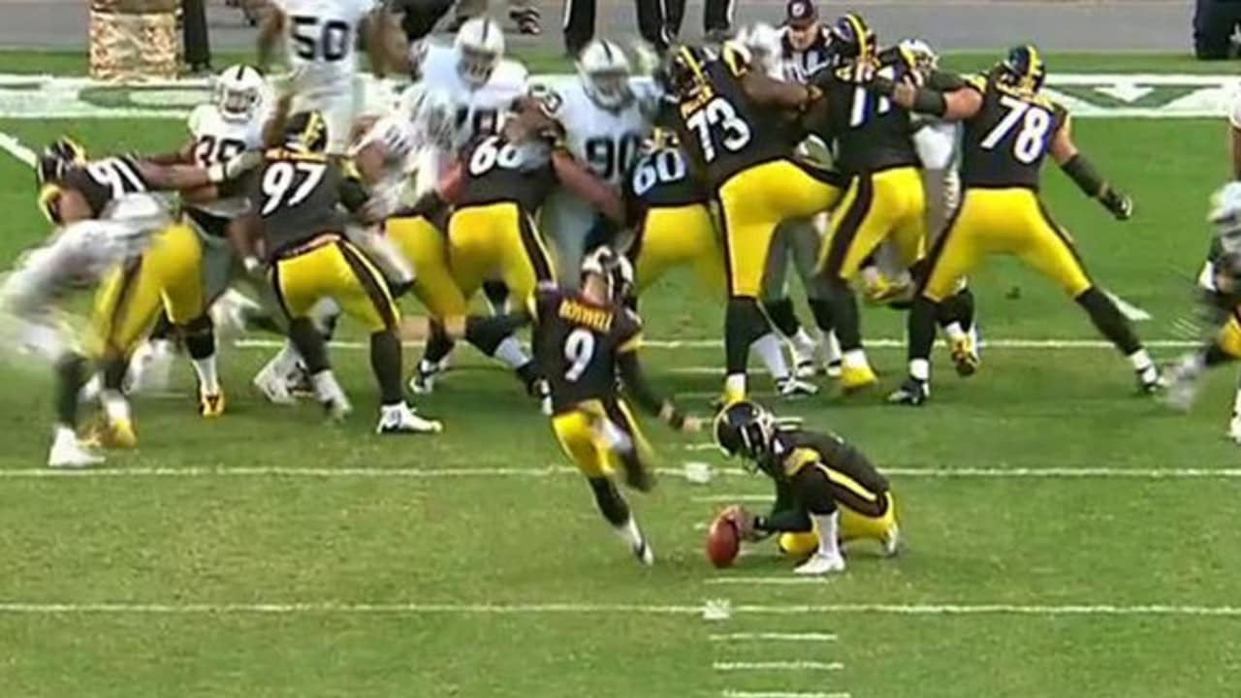
FOCUS

Slide 7
REFERENCES
McGuire, R. Ph.D., Selking, A. Ph.D., & Ivey, P. Ph.D. (2018). Building A Culture Of Mental Toughness: The pyramid model. Championship Productions.
https://www.championshipproductions.com/cgi-bin/champ/p/Performance-Training/Building-a-Culture-of-Mental-Toughness-The-Pyramid-Model_GD-05436.html

